Slide 1
SDN Security Introduction
Chris Shenefiel

Slide 2
What we will cover…
What is SDN
Security considerations
Review of SDN Security: A Survey
Background of LXC, KVM/QEMU and Xen
Questions

Slide 3
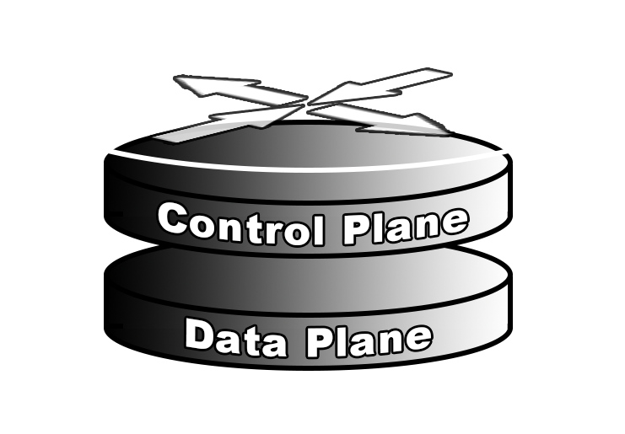
The network paradigm as we now it….
Control and Data Plane resides within Physical Device

Slide 4
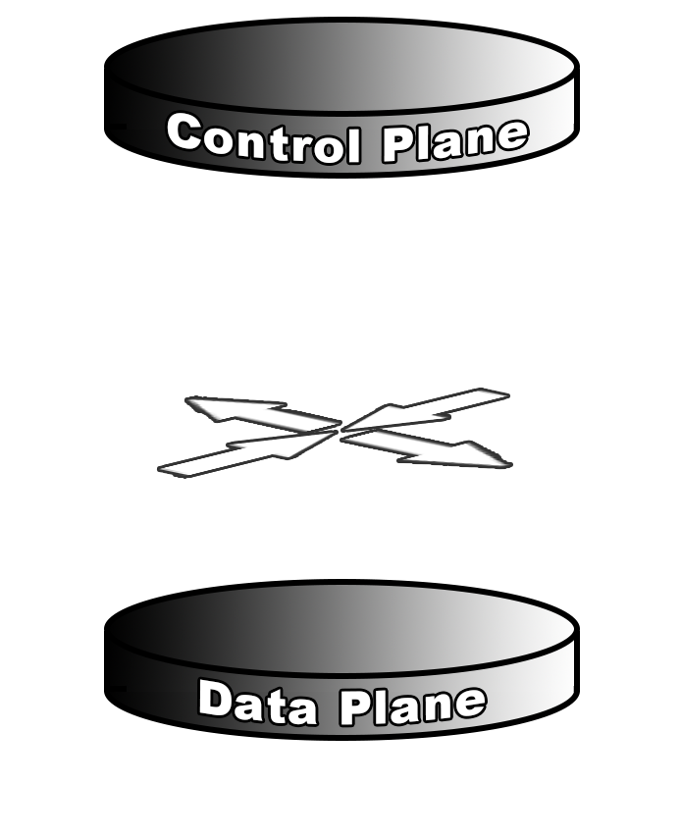
What SDN means
In the SDN paradigm, not all processing happens inside the same device
Notes:
Genesis : Stanford University – Clean Slate Project
OpenFlow is a Layer 2 communications protocol that gives access to the forwarding plane of a network switch or router over the network
OpenFlow is a subset of SDN as defined by the Open Networking Foundation

Slide 5
How SDN is implemented
Multiple applications sending updates to a controller
Controller monitors state of network devices and updates
Updates are synchronized and managed by controller
Application
Application
Application
Controller
Data Plane
Data Plane
Data Plane

Slide 6
Authorization/Authentication Vulnerability
Authenticate between applications and controllers
Recommendation TLS mutual authentication between controller and switches
Application
Application
Application
Controller
Data Plane
Data Plane
Data Plane

Slide 7
Side-channel attacks
Peer into flow rules on the input buffer to learn traffic routing
Monitor packet delays through the data plane to infer the amount of processing done for a given packet
Application
Application
Application
Controller
Data Plane
Data Plane
Data Plane

Slide 8
Denial of Service attacks
Overload the switches by flooding the data communications channel
Overload the switch flow table with too many entries
Application
Application
Application
Controller
Data Plane
Data Plane
Data Plane

Slide 9
Authentication and Integrity Vulnerability
Propose inserting a flow verification stage
Prevents bad configurations from hitting network
Can model network and test updates for damaging consequences
Limitations:
Most only support one controller
Added overhead impacts performance
Application
Application
Application
Controller
VeriFlow/FlowChecker/FlowVisor
Data Plane
Data Plane
Data Plane

Slide 10
Configuration Vulnerability
Policy enforcement
Do configuration changes violate our information security or control policies
Auditing to prove that the network configuration conforms to polices and regulations
Authentication
Are you really who you say you are
Application
Application
Application
Controller
Data Plane
Data Plane
Data Plane

Slide 11
SDN Security Benefits
Dynamically re-route traffic
Contain infected networks/systems
Send traffic to “middle boxes” for further analysis
Continuously reconfigure network to confuse attackers (Moving Target Defense)
Increase security visibility
Monitor or tap any traffic on demand
Detect DDoS
Intrusion detection
Data exfiltration

Slide 12
3 Questions
Q: What benefit and liability do SDN “middle boxes” provide?
Q: What areas did the authors highlight as needing further study?
Q: What security issue from Table 1 would you focus on and why?

Slide 13
Thank You – Questions?

